Slide 1

INSURANCE MANAGEMENT SYSTEM
LRG GOVERNMENT ARTS COLLEGE FOR WOMEN
TIRUPUR
JANANI.S
III – YEAR B.SC COMPUTER SCIENCE
GUIDANCE NAME: MRS. SUGANTHI M.Sc M.phil

Slide 2

OUTLINE
ABSTRACT
OBJECTIVE
HARDWARE SPECIFICATION
SOFTWARE SPECIFICATION
EXISTING SYSTEM
PROPOSED SYSTEM
MODULES
DATAFLOW DIAGRAM
TABLE STRUCTURE
FORM DESIGN

Slide 3
ABSTRACT
This project “Insurance management system” deals with insurance. This tool taking care of the policy tracking the details of the customer. Customer can apply and view their insurance policy details.
This system also calculates agent commission is based upon customer policy registration.
Payment process also like ecommerce transaction. Customers can pay their policies. The payment processes are hassle-free and customer can complete a transaction at a much lesser time.

Slide 4
OBJECTIVE
The main objective of the application is to automate all the possible functionalities of insurance and provide the insurance service to the customers.
Using this system agents and customers can know the details about present policies, new policies, policy specifications, policy terms and conditions, etc.

Slide 5
HARDWARE SPECIFICATION
Processor: P 4 700 ghz. Ram: 4 GB Ram Hard disk drive: 180 GB

Slide 6
SOFTWARE SPECIFICATION
Operating system: windows 7/8/10 Front end: PYTHON Back end: MYSQL

Slide 7
EXISTING SYSTEM
The existing system is the manual system. It is time consuming. It is difficult to search for a data most of the insurance organizations are not having any existing fully computerized system. It is very difficult for a person to produce the report.
There are chances for changing the scheme report and do malpractice. They are managing the information in the form of excel spread sheets.
This system involves a lot of manual entries with the applications to perform the desired task. Every member organization has its own data structure.
Usage of papers in the payment process leads to less efficiency, less accuracy and less productivity. Due to lack of centralized data structure, it is very difficult to merge the data to analyze the statistics
DISADVANTAGE: Huge process of creating an insurance account More number of papers are wasted for insurance No records can be maintained

Slide 8
PROPOSED SYSTEM
The proposed system is for making easier to manage policy holder details, agent details, policy details, claimant details and payment details.
The proposed system is designed to eliminate the drawbacks of the existing system. It is designed by keeping to eliminate the drawbacks of the present system in order to provide a permanent solution to the problems.
The primary aim of the new system is to speedup transactions.
The overall system is control through the main menu. The report is prepared for the schemes and implemented by the concerned officials.
Advantages Can easily contact the agent
All the records are maintained by the administrator
Easy to manage the software

Slide 9

MODULES
Policy Registration Module
Customer account module
Policy payment module
Agent Registration module
Report module

Slide 10
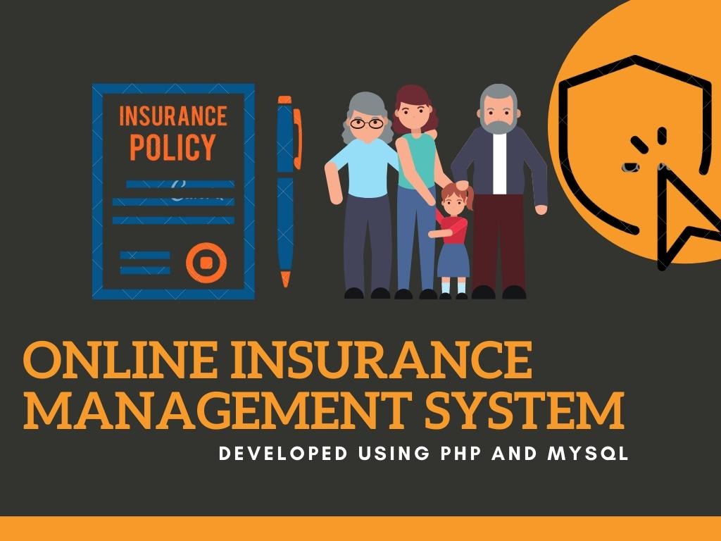
MODULES
Policy registration module:
New policy holder gives their information like, name, password, age, sex, address, e-mail id.
Customer account module:
The customer account module is when the customer
registers the form and can able to access login, here
they can check the customer account details as well
as policy renewal.

Slide 11
Policy payment:
This module the customer can directly pay the insurance renewal for this module, once the date has crossed then the user will get the alert for the policy details then can pay it.
Agent registration module:
An agent can able to register by the administrator, once the agent has been added they will have unique username and password. Using this credential to login into the application. Once they register, they can able to create the customer account.

Slide 12
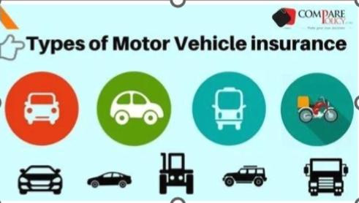
Report Module:
Admin can view various kinds of report. Admin can view :
Customer report
Agent report
Policy Payment report
Withdrawal report
Insurance account report
Transaction report

Slide 13
DATAFLOW DIAGRAM
LEVEL 0:
Username Username
Password Password
Insurance management system
Admin
Agent
Customer

Slide 14
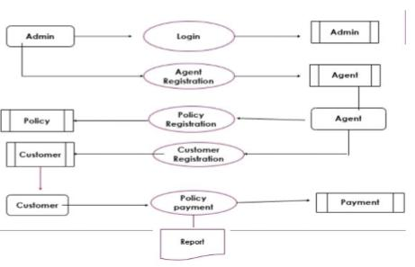
LEVEL 1:

Slide 15
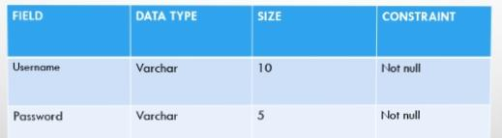
TABLE STRUCTURE
Table Name: Admin

Slide 16
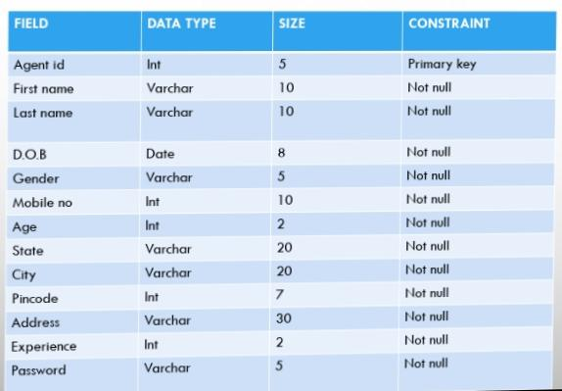
Table Name: Agent

Slide 17
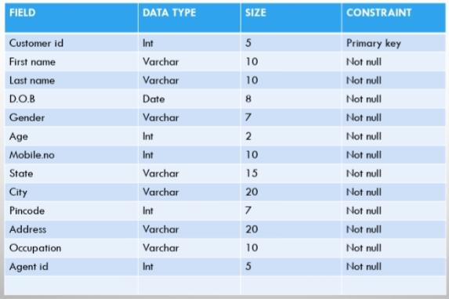
Table Name: Customer

Slide 18
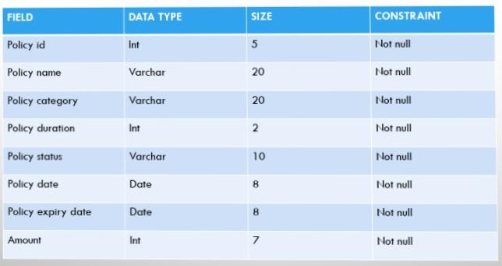
Table Name: Policy

Slide 19
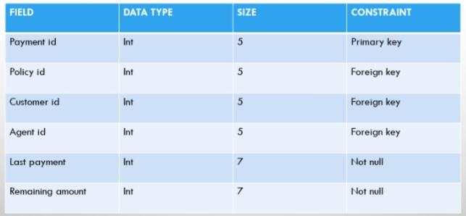
Table Name: Payment

Slide 20
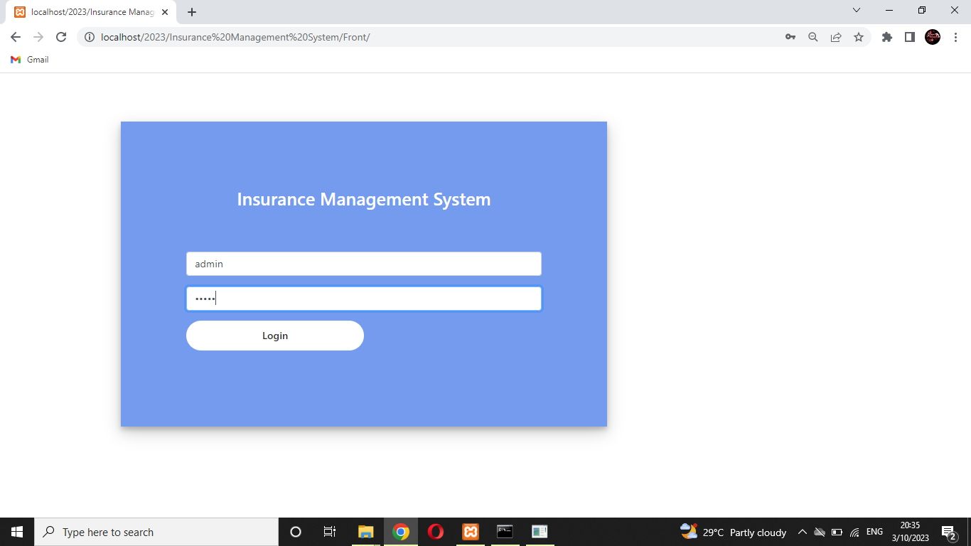
FORM DESIGN
ADMIN LOGIN

Slide 21
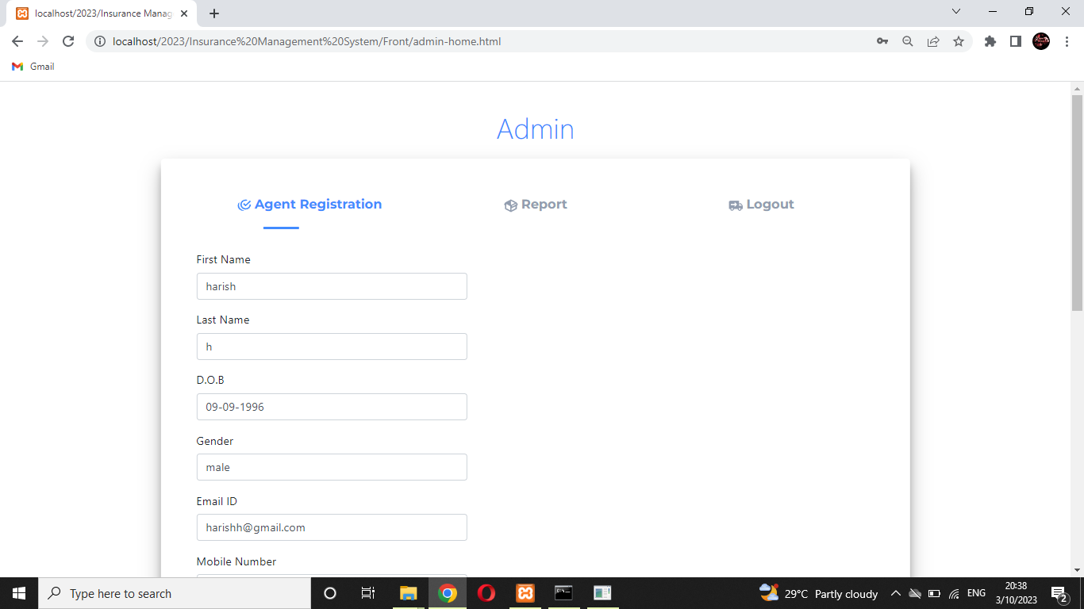
AGENT REGISTRATION PAGE:

Slide 22
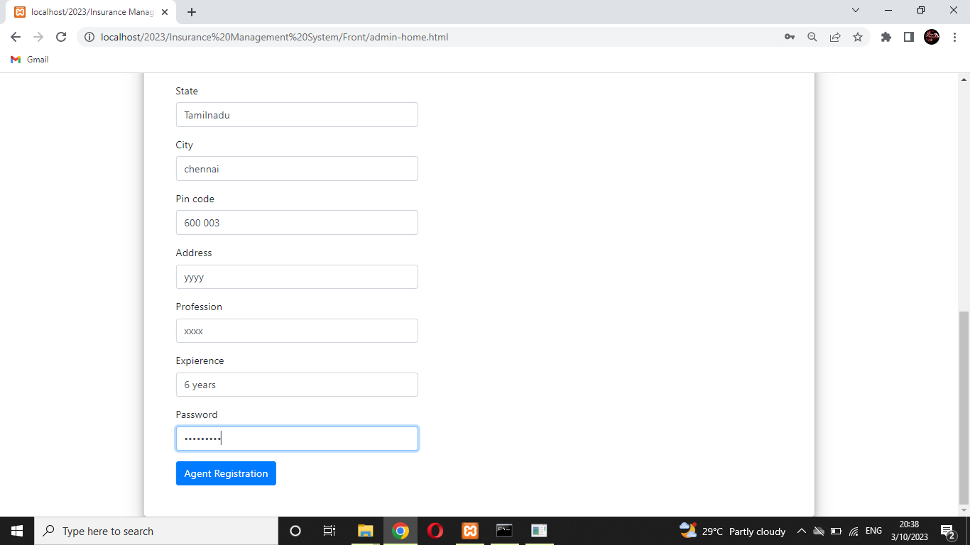

Slide 23
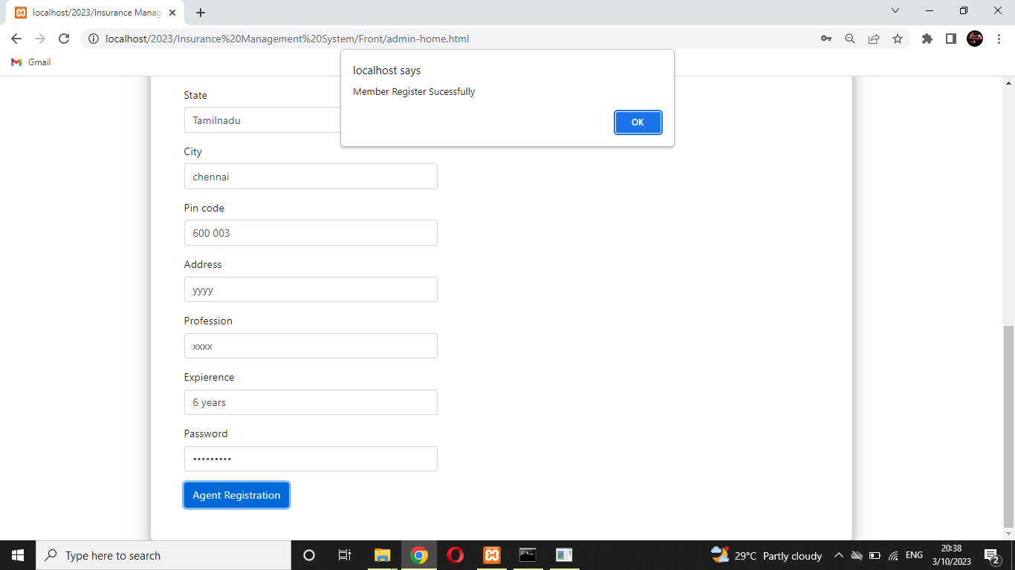

Slide 24
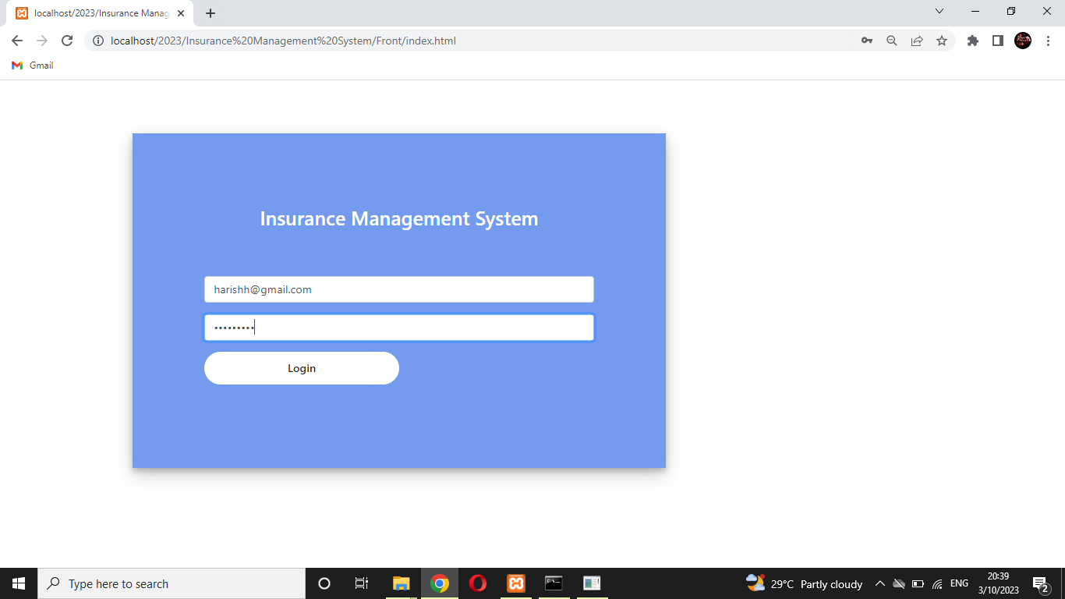
AGENT LOGIN PAGE

Slide 25
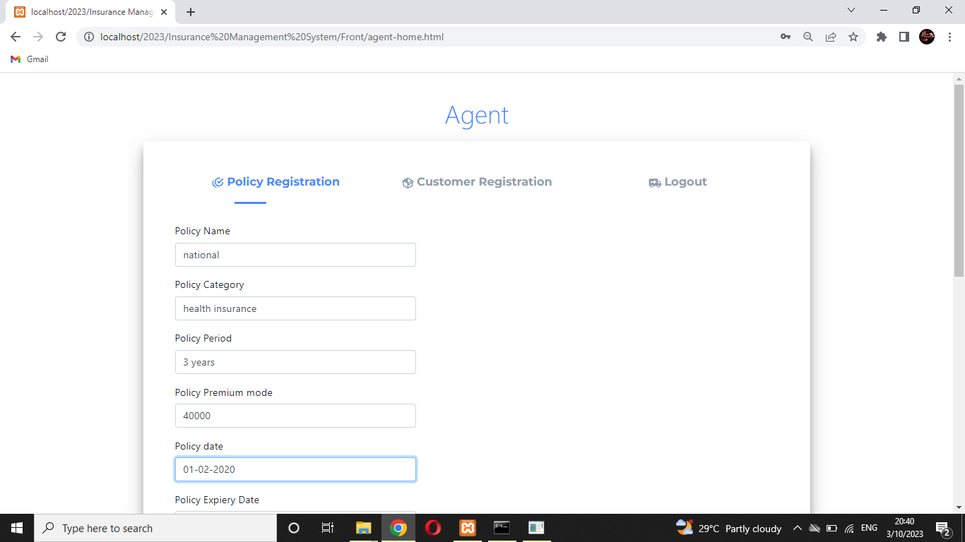
Policy Registration

Slide 26
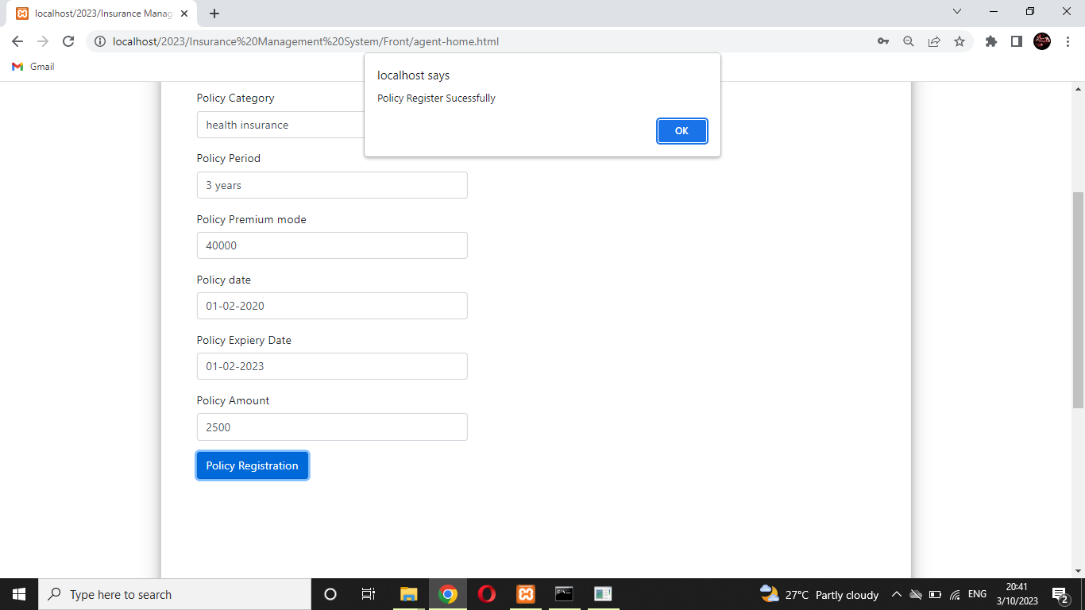

Slide 27
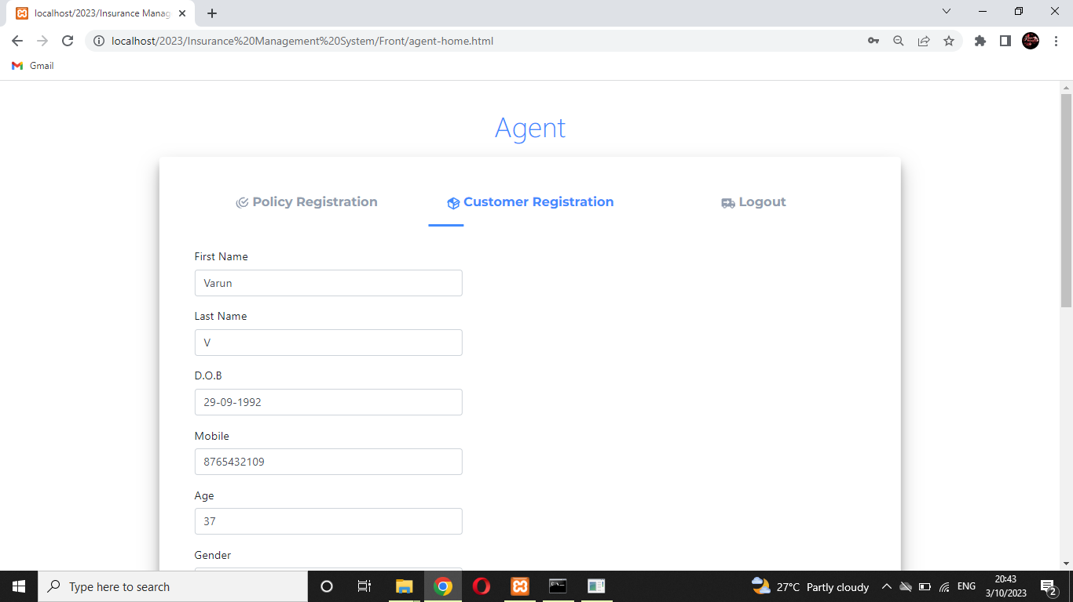
CUSTOMER REGISTRATION PAGE:

Slide 28
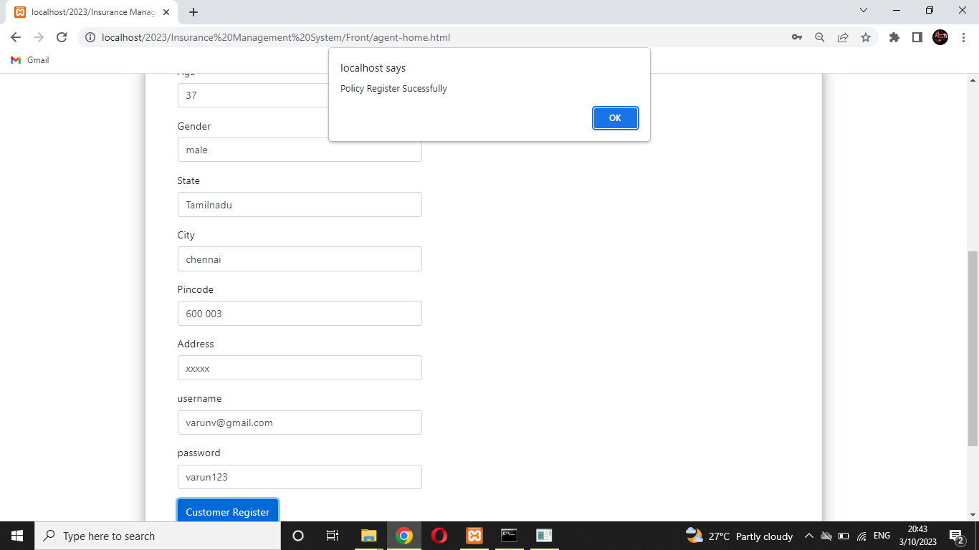

Slide 29

CUSTOMER LOGIN PAGE :

Slide 30
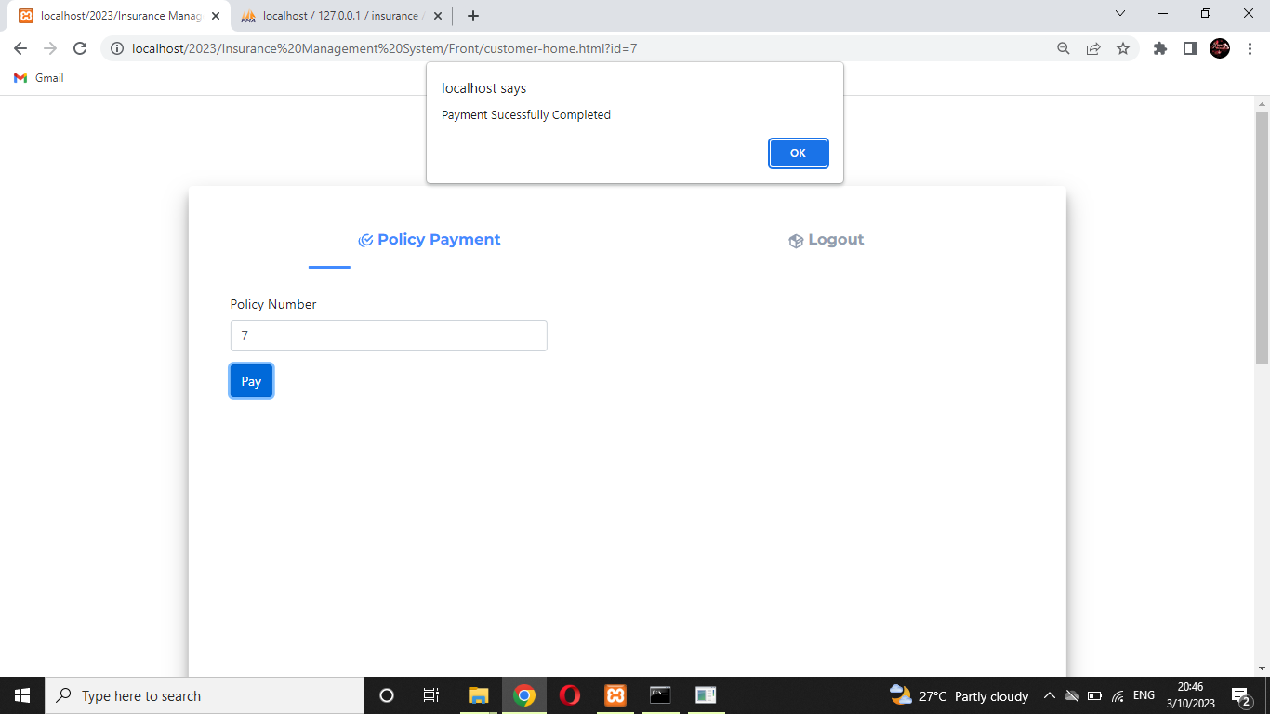
PAYMENT PAGE:

Slide 31
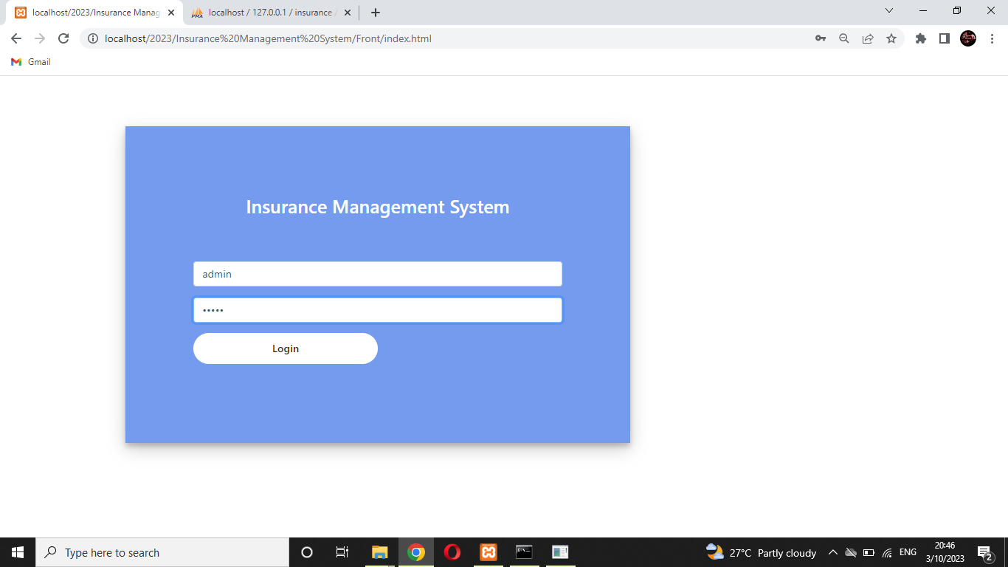
ADMIN LOGIN PAGE :

Slide 32
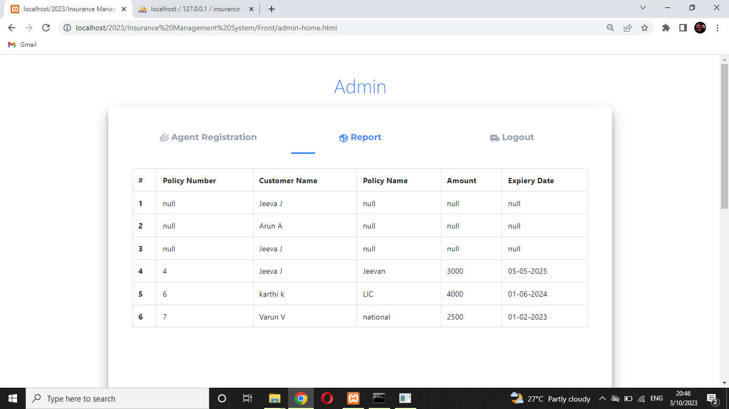
REPORT PAGE:

Slide 33
THANK YOU

